Slide 1
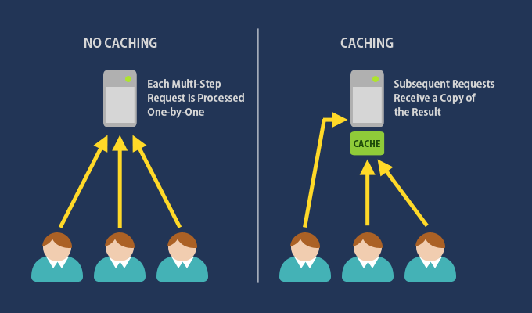
Caching significantly improves the performance of an application, reducing the complexity to generate content. It is important to design an application so that it never depends directly on the cached memory. The application should only cache data that don't change frequently and use the cache data only if it is available.
ASP.NET Core has many caching features. But among them
the two main types are,
In-memory caching
Distributed Caching
Caching refers to the process of storing frequently used data so that those data can be served much faster for any future requests. So we take the most frequently used data and copy it into temporary storage so that it can be accessed much faster in future calls from the client. If we try to explain with a simple example, Let User-1 request some data and it takes 12-15 seconds for the server to fetch the data. While fetching, we will make a copy of our fetched data parallelly to any temporary storage. So now, when User-2 requests the same data, this time we will simply serve his from the cache and it will take only 1-2 seconds for the response as we already stored the response in our cache.
There are two important terms used with cache, cache hit and cache miss. A cache hit occurs when data can be found in a cache and a cache miss occurs when data can't be found in the cache.

Slide 2
In-memory caching
An in-memory cache is stored in the memory of a single server hosting the application. Basically, the data is cached within the application. This is the easiest way to drastically improve application performance.
The main advantage of In-memory caching is it is much quicker than distributed caching because it avoids communicating over a network and it's suitable for small-scale applications. And the main disadvantage is maintaining the consistency of caches while deployed in the cloud.
The InMemory cache which uses ImemoryCache interface requires NuGet package "Microsoft.Extensions.Caching.Memory"
The In-Memory caching is a service called by dependency injection in the application, so we register it in the Configure Services in program.cs file , as per the following code snippet.
builder.Services.AddMemoryCache();

Slide 3
Implement In-Memory Cache
To implement the In-Memory cache, we create a Controller named HomeController. This Controller holds the implementation of the In-Memory cache.
Now, we create ImemoryCache interface instance in the HomeController using constructor dependency injection. The following code snippet can be used for the same
using Microsoft.AspNetCore.Mvc;
using Microsoft.Extensions.Caching.Memory;
using System;
namespace MemoryCacheApplication.Controllers
{
public class HomeController : Controller
{
private readonly IMemoryCache memoryCache;
public HomeController(IMemoryCache memoryCache)
{
this.memoryCache = memoryCache;
}
}
}

Slide 4
Now, we need to create an action method named Index. This action method sets data in the cache. The following code snippet is for the same.
public IActionResult Index()
{
DateTime currentTime;
bool isExist = memoryCache.TryGetValue("CacheTime", out currentTime);
if (!isExist)
{
currentTime = DateTime.Now;
var cacheEntryOptions = new MemoryCacheEntryOptions()
.SetSlidingExpiration(TimeSpan.FromSeconds(30));
memoryCache.Set("CacheTime", currentTime, cacheEntryOptions);
}
return View(currentTime);
}
The above code snippet has consumed some methods of InMemory cache service for reading and writing the data in the cache.
TryGetValue This method reads value and assigns it in out parameter. It returns true if the value exists otherwise returns false. Set This method writes data in the cache. This method has three options - Cache Key name, data which is to be cached, and expiration option respectively.
SetSlidingExpiration It sets cache expiration from absolute to sliding. When we make another request with expiration time, then it will be renewed with each response. Now, we create a View named "Index" under Views/Home folder for the Index action method as per the following code snippet.

Slide 5
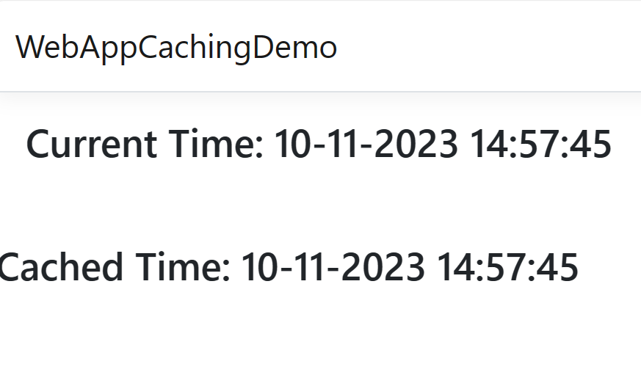
@model DateTime?
<div class="row">
<div class="col-md-3">
<h3> Current Time: @DateTime.Now.ToString()</h3>
</div>
<div class="col-md-3">
<h3>Cached Time: @Model.Value.ToString()</h3>
</div>
</div>
The above code shows current time and cached time. Now, we will run the application and make another request within 30 seconds with the same client. The result shows as per the below figure.
The result shows that when we request within expiration time, then it returns cache data.

Slide 6
Read and Write In-Memory Cache
The In-Memory Cache provides another option to read and write data in the cache. There are two methods - Get and GetOrCreate.
Get This method is used to get cached data. It takes cache key as a parameter and returns data stored based on this key.
GetOrCreate If the data exists for a cache key, then this method reads that data and returns. If cache data for that cache key doesn’t exist, then it writes data in the cache.
Now, we will create another example in the same application while using these two methods. We have created View Model named CacheViewModel as per the following code snippet.
using System;
namespace MemoryCacheApplication.Models
{
public class CacheViewModel
{
public DateTime? FirstTime { get; set; }
public DateTime SecondTime { get; set; }
}
}

Slide 7
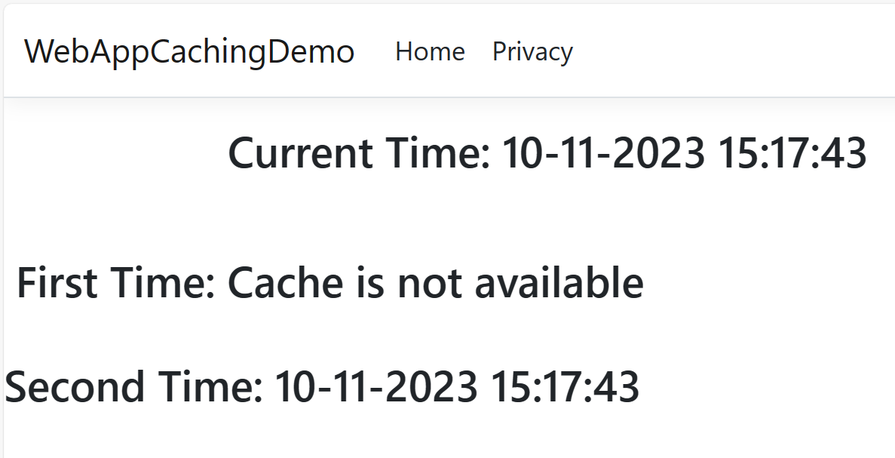
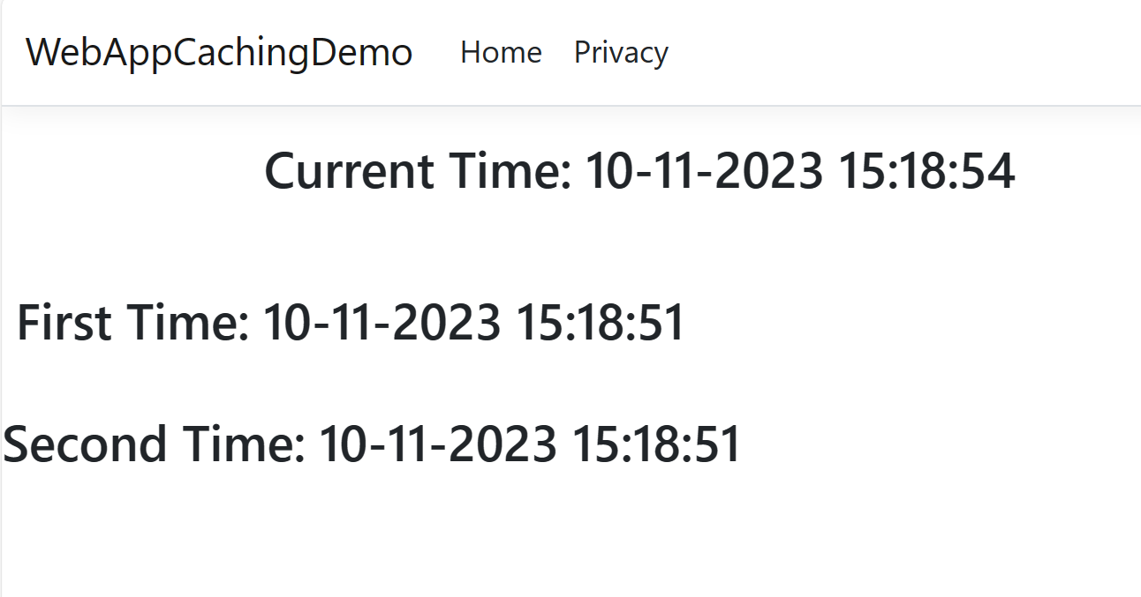
Now, create Index action method in HomeController. This action method implements both cache In-Memory methods. See the code snippet.
public IActionResult Index()
{
CacheViewModel model = new CacheViewModel
{
FirstTime = memoryCache.Get<DateTime?>("CacheTime"),
SecondTime = memoryCache.GetOrCreate("CacheTime", entry =>
{
entry.SlidingExpiration = TimeSpan.FromSeconds(45);
return DateTime.Now;
})
};
return View(model);
}
The above code shows the current time and cached time.
Now, we will run the application and make another request within 45 seconds with the same client. The result shows as per the below figure for both methods.
Now, we create a View named "Index" under Views/Home folder for the Index action method, as per the following code snippet.
@model MemoryCacheApplication.Models.CacheViewModel
<div class="row">
<div class="col-md-3">
<h3> Current Time: @DateTime.Now.ToString()</h3>
</div>
<div class="col-md-3">
<h3> First Time: @(Model.FirstTime.HasValue?Model.FirstTime.ToString():"Cache is not available")</h3>
</div>
<div class="col-md-3">
<h3>Second Time: @Model.SecondTime.ToString()</h3>
</div>
</div>

Slide 8
Remove Data from In-Memory Cache
The In-Memory cache can be evicted either automatically or manually. There are some cases when cache evicts automatically.
Sliding Expiration We set the value in timespan for how long a cache entry can be inactive before removing it from the cache. If a request doesn't make for that period, then it removes automatically.
There is Remove method of IMemoryCache interface which removes the cache from the memory. We create Index action method which writes data in the cache if cache does not exist already. The following code snippet is used for the same.
Now, we will create a View named Index under Views/Home folder for the Index action method as per following code snippet.
@model DateTime?
<form asp-controller="DemoRemove" asp-action="RemoveCache">
<input type="submit" class="btn btn-danger" value="Remove" />
</form>
<div class ="row">
<div class ="col-md-3">
<h3> Current Time: @DateTime.Now.ToString()</h3>
</div>
<div class ="col-md-3">
<h3> Cache Time: @(Model != null ? @Model.ToString() : "Cache is not available")</h3>
</div>
<div class ="col-md-3">
</div>
</div>
[HttpGet]
public IActionResult Index()
{
DateTime currentTime = memoryCache.GetOrCreate("CacheTime", entry =>
{
entry.SlidingExpiration = TimeSpan.FromSeconds(45);
return DateTime.Now;
});
return View(currentTime);
}

Slide 9
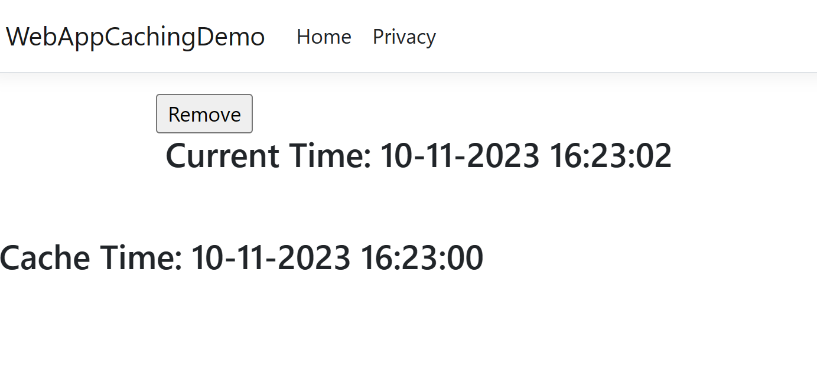
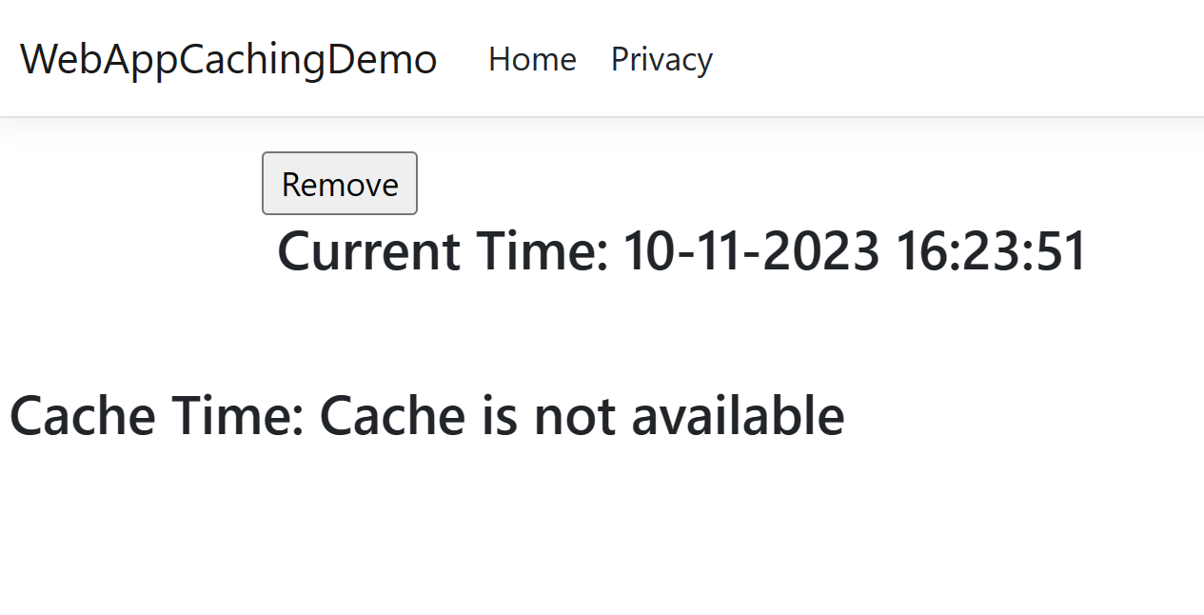
Now, run the application. It shows both current time and cached data along with Remove button. When clicked on Remove button, it calls action method and removes the cached data.
[HttpPost]
public IActionResult RemoveCache()
{
memoryCache.Remove(“CacheTime”)
return View(“Index”);
}

Slide 10
public static class CacheExtensions
{
public static TItem Get<titem>(this IMemoryCache cache, object key);
public static TItem Set<titem>(this IMemoryCache cache, object key, TItem value, MemoryCacheEntryOptions options);
public static bool TryGetValue<titem>(this IMemoryCache cache, object key, out TItem value);
...
}
services.AddMemoryCache();
The AddMemoryCache method allows us to register the IMemoryCache interface that, as mentioned above, is the basis to be used for the caching. Below we see the definition of the interface in the framework:
If we are not sure that a specific key is present in our cache, the TryGetValue() method comes to help: it returns a Boolean, that indicates the existence or non-existence of the requested key.
Below is how you can modify the Get() method using the TryGetValue.
public interface IMemoryCache : IDisposable
{
bool TryGetValue(object key, out object value);
ICacheEntry CreateEntry(object key);
void Remove(object key);
}
[HttpGet(“{key}”)]
public string Get(string key)
{
string obj;
if (!cache.TryGetValue<string>(key, out obj))
obj = DateTime.Now.ToString();
cache.Set<string>(key, obj);
return obj;
}
Methods present in the interface are not the only ones available to work with the cache: there are different extensions that enrich the available APIs and greatly facilitate their use, as we will see later. For example:

Slide 11
We can indicate a fixed time after which a certain key expires (absolute expiry), or it can expire if it is not accessed after a certain time (sliding expiry).
Cache Tag Helper
We have seen so far the use of APIs made available by .NET Core, to be able to manually write and read item in the cache using the IMemoryCache interface directly.
There are also other implementations of this interface, that can be very useful. For example, in the Web environment, if we use the .NET Core MVC framework, we can store parts of pages using the helper cache tag. It’s really simple to use: you can wrap part of a view in cache tags to enable caching:
private readonly IMemoryCache _cache;
public CachedemoController(IMemoryCache _cache)
{
this. _cache = _cache;
}
//absolute expiration using TimeSpan
_cache.Set("key", item, TimeSpan.FromDays(1));
//absolute expiration using DateTime
_cache.Set("key", item, new DateTime(2020, 1, 1));
//sliding expiration
_cache.Set("key", item, new MemoryCacheEntryOptions
{
SlidingExpiration = TimeSpan.FromDays(7)
});
//use both absolute and sliding expiration
_cache.Set("key", item, new MemoryCacheEntryOptions
{
AbsoluteExpirationRelativeToNow = TimeSpan.FromDays(30),
SlidingExpiration = TimeSpan.FromDays(7)
});
<cache>
<p>Ora: @DateTime.Now</p>
</cache>
The first request to the page that contains the Tag Helper displays the current date. Additional requests show the cached value until the cache expires (default 20 minutes) or until the cached date is evicted from the cache.
<cache expires-on="@new DateTime(2025,1,29,17,02,0)">
@---------
</cache>

Slide 12
Caching in the browser
You can set cache headers manually using Response.Headers but the preferred approach for caching actions is to make use of the ResponseCache attribute which can be applied to both actions and controllers.
[ResponseCache(Duration = 3600)]
Duration is measures in seconds so the above attribute would cache the page in the browser for 3600 seconds or one hour.
Instead of specifying values for each instance of the attribute, we can also configure one or more cache profiles.
Cache profiles are configured in ConfiguresServices when you add the MVC middleware:
Builder.Services.AddMvc(options =>
{
options.CacheProfiles.Add("Hourly", new CacheProfile()
{
Duration = 60 * 60 // 1 hour
});
options.CacheProfiles.Add("Weekly", new CacheProfile()
{
Duration = 60 * 60 * 24 * 7 // 7 days
});
});
You can then reference the cache profile names in the ResponseCache attributes
[ResponseCache(CacheProfileName = "Weekly")]
You can also explicitly disable any caching with the following:
[ResponseCache(Location = ResponseCacheLocation.None, NoStore = true)]
Note that both Location and NoStore are required. NoStore returns the standard "cache-control: no-store" header but some older proxies do not understand this so Location = ResponseCacheLocation.None adds "no-cache" values to cache-control and pragma headers.

Slide 13
using Microsoft.AspNetCore.Mvc;
using Microsoft.EntityFrameworkCore;
using WebAppSqlserver.Models;
namespace WebAppSqlserver
{
public class Program
{
public static void Main(string[] args)
{
var builder = WebApplication.CreateBuilder(args);
// Add services to the container.
builder.Services.AddControllersWithViews(
options =>
{
options.CacheProfiles.Add("Hourly", new CacheProfile()
{
Duration = 60 * 60 // 1 hour
});
options.CacheProfiles.Add("Weekly", new CacheProfile()
{
Duration = 60 * 60 * 24 * 7 // 7 days
});
});
builder.Services.AddScoped<IEmployeeRepository, SqlemployeeRepository>();
builder.Services.AddDbContextPool<Appdbcontext>(
options => options.UseSqlServer(builder.Configuration.GetConnectionString("EmployeeDBConnection")));
builder.Services.AddMemoryCache();
builder.Services.AddResponseCaching();
var app = builder.Build();
// Configure the HTTP request pipeline.
if (!app.Environment.IsDevelopment())
{
app.UseExceptionHandler("/Home/Error");
// The default HSTS value is 30 days. You may want to change this for production scenarios, see https://aka.ms/aspnetcore-hsts.
app.UseHsts();
}
app.UseHttpsRedirection();
app.UseStaticFiles();
app.UseResponseCaching();
app.UseRouting();
app.UseAuthorization();
app.MapControllerRoute(
name: "default",
pattern: "{controller=Home}/{action=Index}/{id?}");
app.Run();
}
}
}
Response cache is browser dependent
Not supported in chrome
But firefox do support

Slide 14
Task :
Create MVC Core Crud.
When you load page let all employee detail should com from database but
On Second request it should come fromCache memory

Slide 15
Cache Tag Helper Attributes
enabled
enabled determines if the content enclosed by the Cache Tag Helper is cached. The default is true. If set to false, the rendered output is not cached.
Example:
<cache enabled="true"> Current Time Inside Cache Tag Helper: @DateTime.Now </cache>
expires-on
expires-on sets an absolute expiration date for the cached item.
The following example caches the contents of the Cache Tag Helper until 5:02 PM on January 29, 2025:
<cache expires-on="@new DateTime(2025,1,29,17,02,0)"> Current Time Inside Cache Tag Helper: @DateTime.Now </cache>
expires-after
expires-after sets the length of time from the first request time to cache the contents.
Example:
<cache expires-after="@TimeSpan.FromSeconds(120)"> Current Time Inside Cache Tag Helper: @DateTime.Now </cache>
The Razor View Engine sets the default expires-after value to twenty minutes.
expires-sliding
Sets the time that a cache entry should be evicted if its value hasn't been accessed.
Example:
<cache expires-sliding="@TimeSpan.FromSeconds(60)"> Current Time Inside Cache Tag Helper: @DateTime.Now </cache>
vary-by-header
vary-by-header accepts a comma-delimited list of header values that trigger a cache refresh when they change.
The following example monitors the header value User-Agent. The example caches the content for every different User-Agent presented to the web server:
<cache vary-by-header="User-Agent"> Current Time Inside Cache Tag Helper: @DateTime.Now </cache>
vary-by-query
vary-by-query accepts a comma-delimited list of Keys in a query string (Query) that trigger a cache refresh when the value of any listed key changes.
The following example monitors the values of Make and Model. The example caches the content for every different Make and Model presented to the web server:
<cache vary-by-query="Make,Model"> Current Time Inside Cache Tag Helper: @DateTime.Now </cache>

Slide 16
vary-by-route
vary-by-route accepts a comma-delimited list of route parameter names that trigger a cache refresh when the route data parameter value changes.
Example:
Startup.cs:
C#
routes.MapRoute( name: "default", template: "{controller=Home}/{action=Index}/{Make?}/{Model?}");
Index.cshtml:
CSHTML
<cache vary-by-route="Make,Model"> Current Time Inside Cache Tag Helper: @DateTime.Now </cache>

